Slide 1

Rust 101
Introduction

Slide 2
Why use Rust?

Slide 3

It makes you feel like a genius

Slide 4
Empowerment
Reducing barrier to access
Eliminate common pitfalls
Guides you to reliable, efficient code
Expressive and flexible
Voted “Most loved language” (since 2015)

Slide 5




Your code just works
Code should be able to run without crashing first time
Borrow checker promises that it is memory-safe
Compilation errors have become excellent.
Industry-ready and present in many large codebases

Slide 6


Slide 7
Fearless Concurrency
Type system promises race condition freedom at compile time
Simple constraints on how to interact with memory
Well-designed concurrency primitives
Libraries (like Rayon) make parallelisation easy & practical
Concurrency becomes simple in Rust!

Slide 8
Blazingly fast
Suite of well-optimised data structures that just work
No garbage collection
Monomorphisation means generic code produces optimised code
Same old LLVM backend
Zero-cost abstractions

Slide 9
Seamless Interoperability
Foreign Function Interface (FFI) allows for seamless interoperability with different languages
No of garbage collector means easy C compatibility
Software today uses Rust code in Python, C, C++, Go, etc
Rust can be inserted into a lot of codebases, today, headache-free!

Slide 10
Okay, so I’m convinced. What now?

Slide 11

A brief tour of Rust

Slide 12


Slide 13
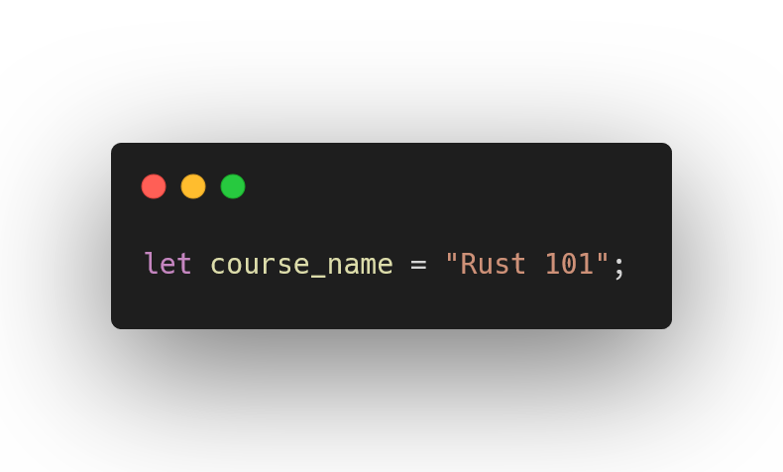
Let Bindings

Slide 14
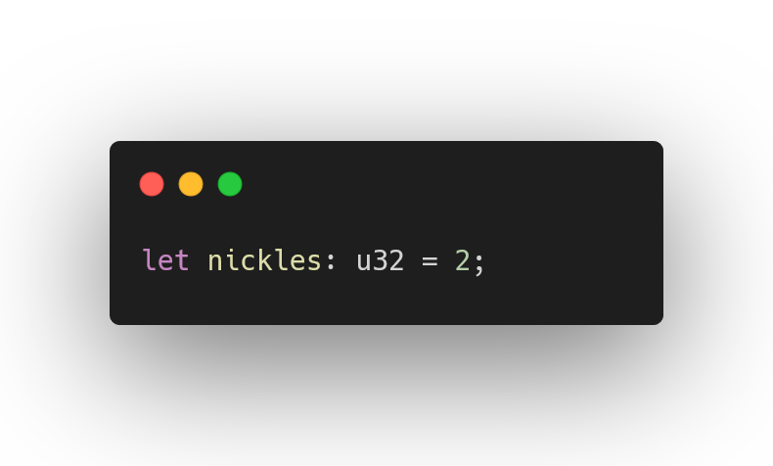
Variable Types

Slide 15
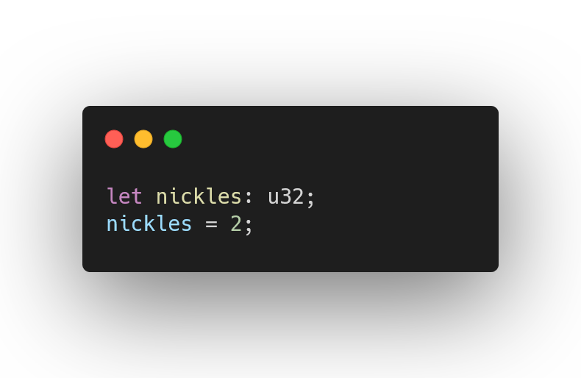
Annotations

Slide 16
In general, default to using i32

Slide 17
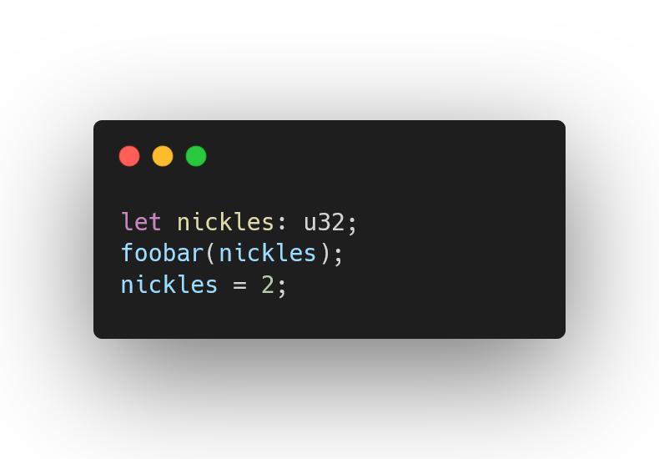
Uninitialized Variables

Slide 18
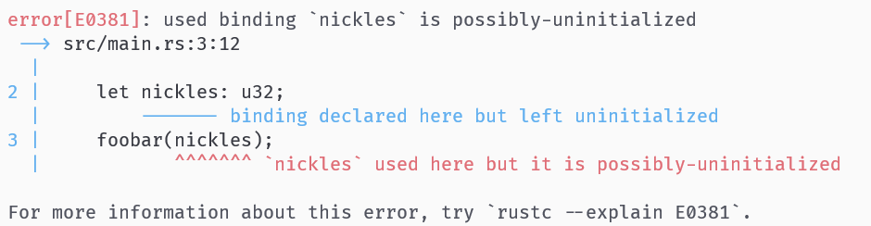
Uninitialized Variables

Slide 19
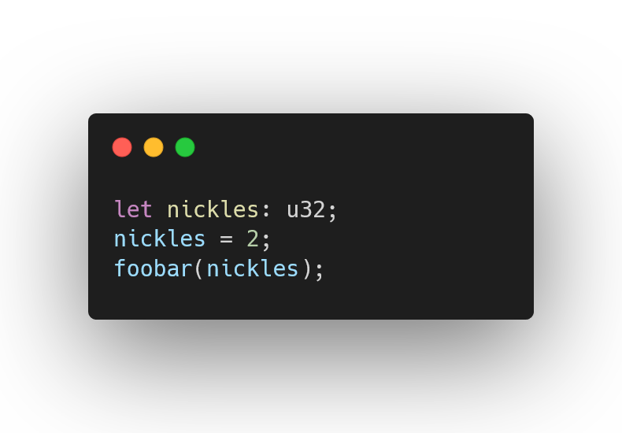
Initialised Variables

Slide 20
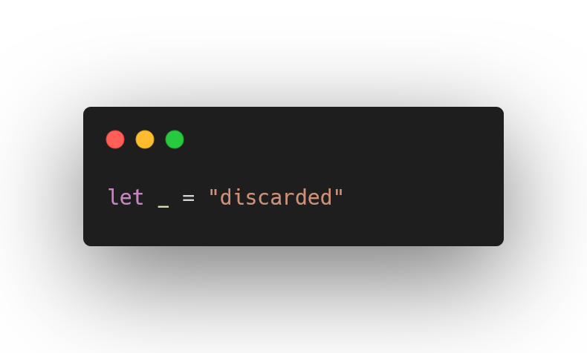
Unused Variables

Slide 21
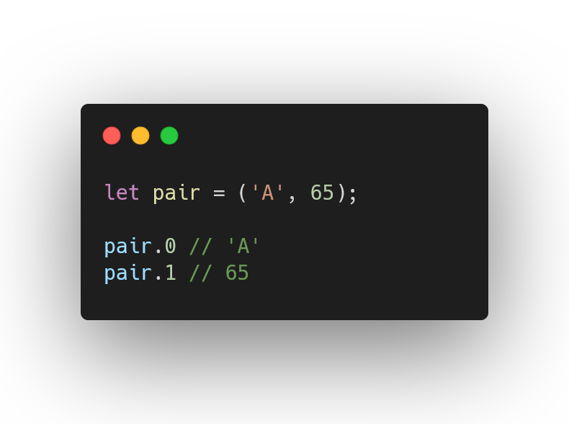
Tuples

Slide 22
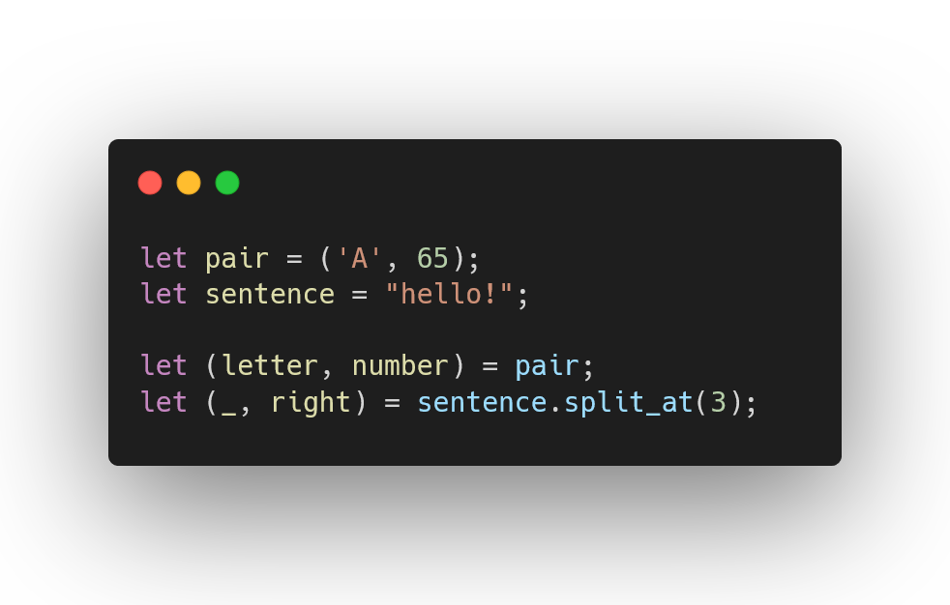
Destructuring

Slide 23
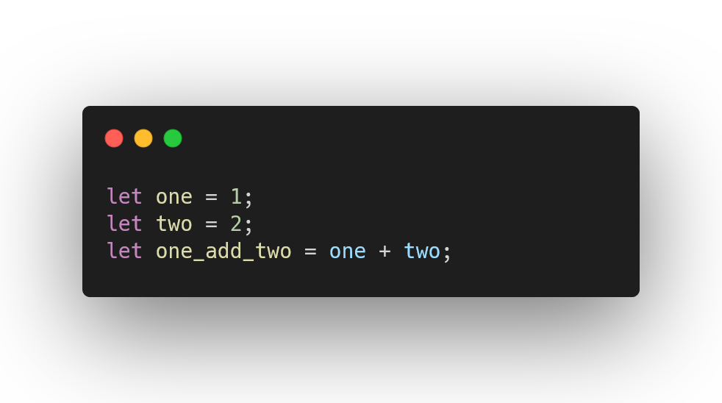
Statements

Slide 24
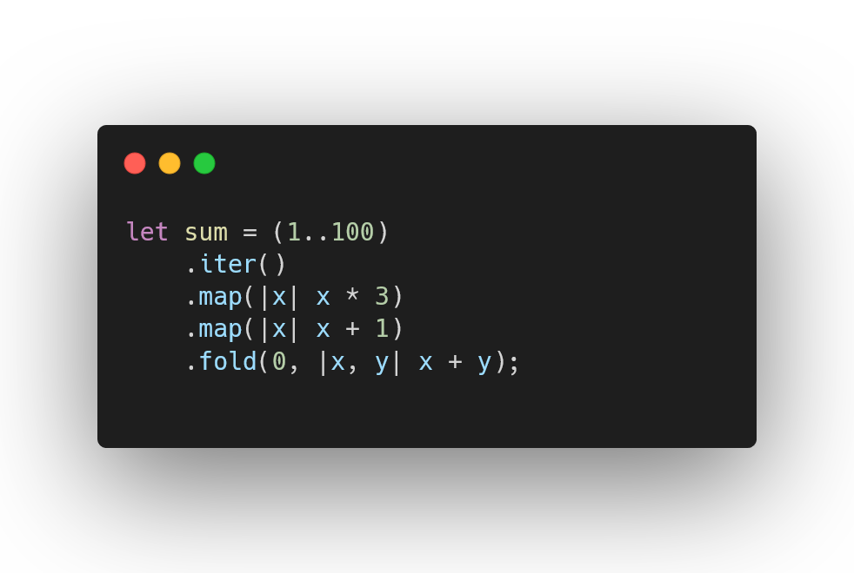
Multiline Statements

Slide 25
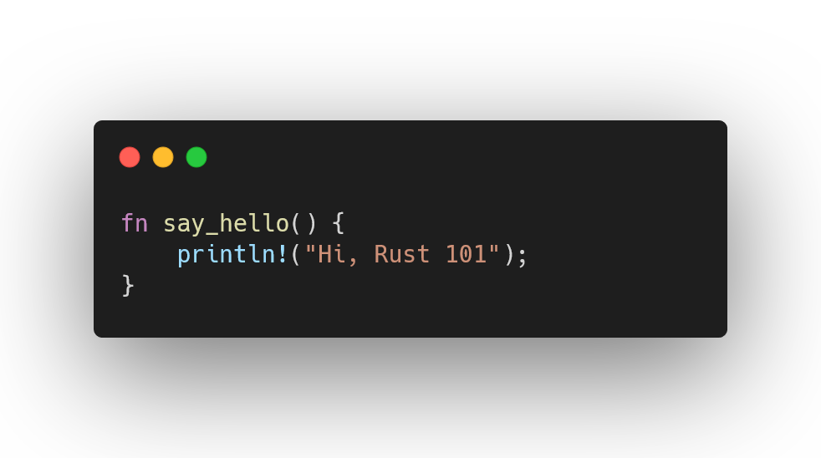
Functions

Slide 26
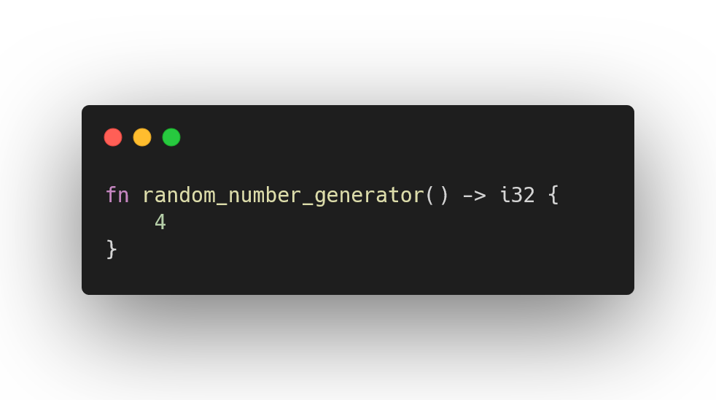
Returning Values

Slide 27
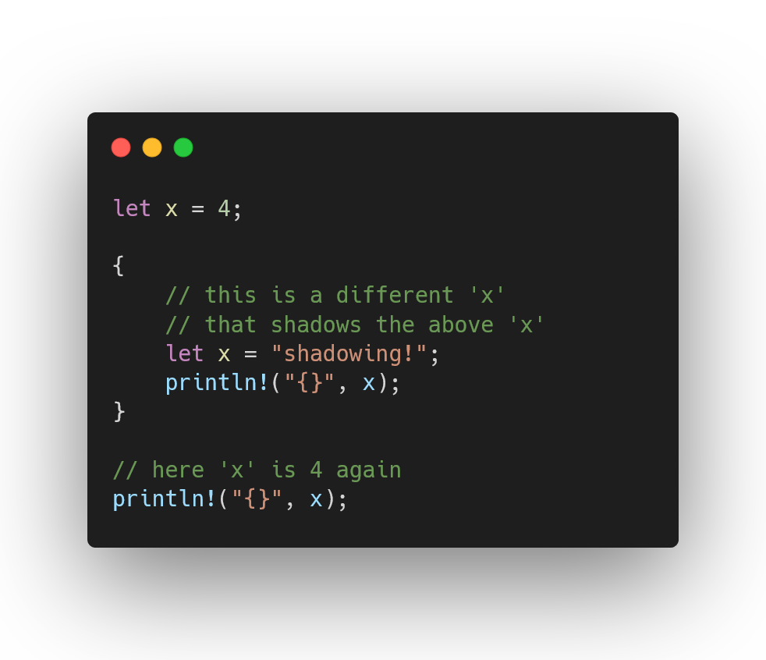
Blocks denote a new scope

Slide 28
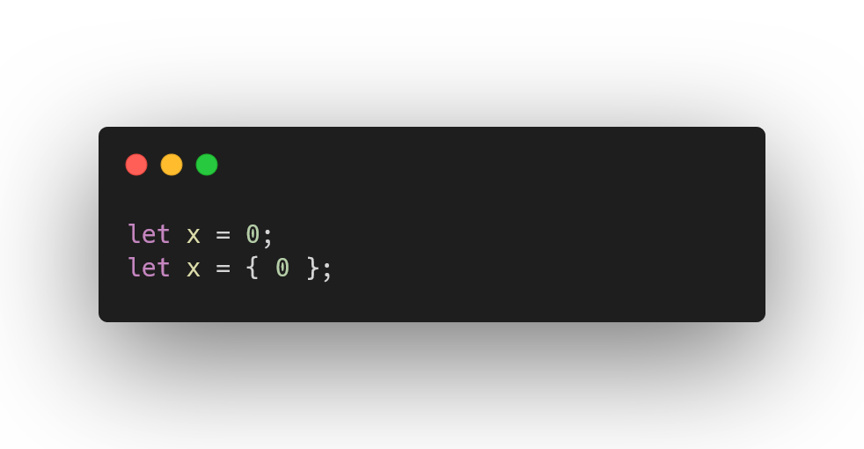
Blocks are expressions

Slide 29
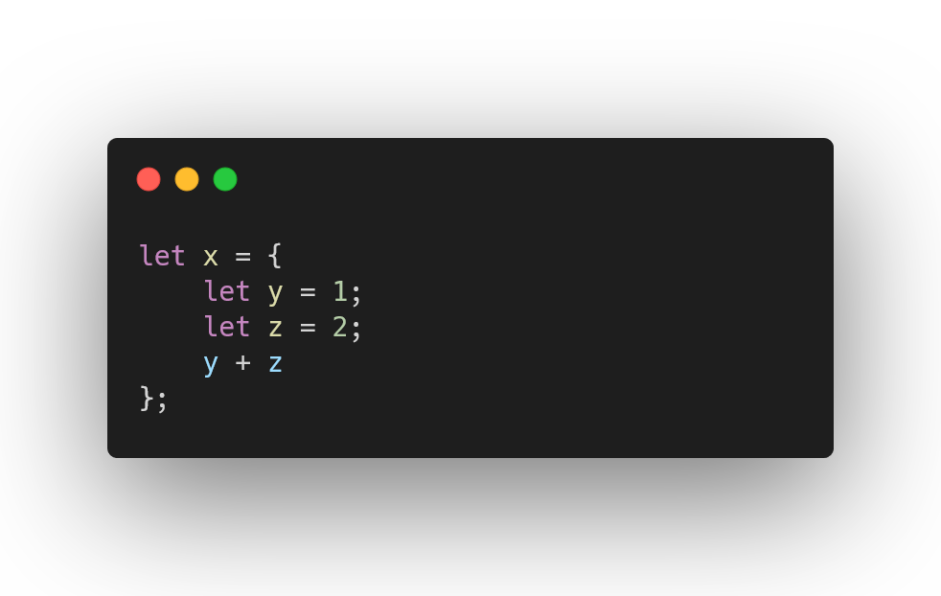
Blocks can have statements

Slide 30
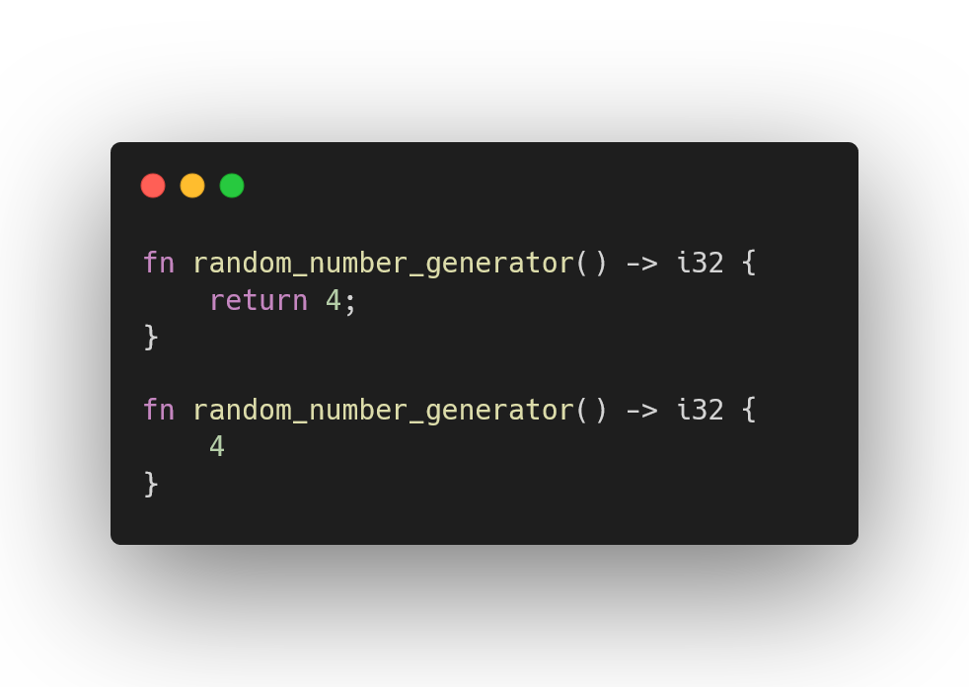
These functions are identical

Slide 31
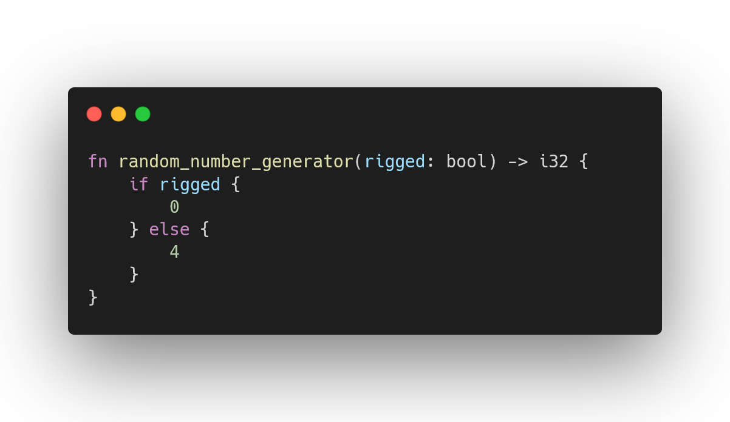
If statements are expressions

Slide 32
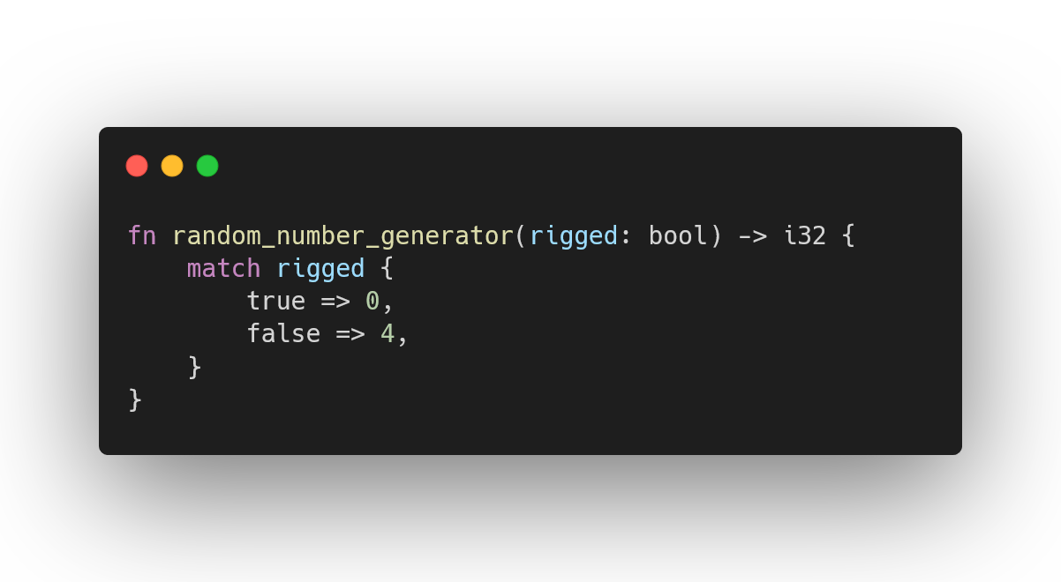
Match statements are expressions

Slide 33
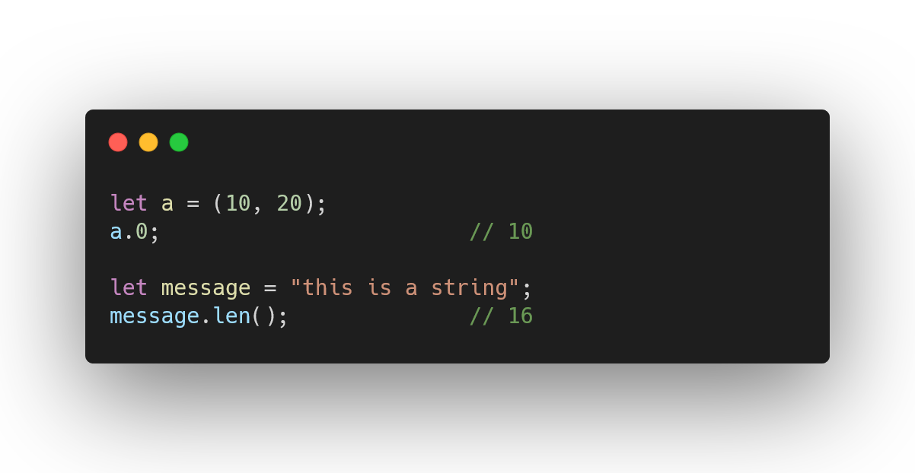
Attributes & methods are familiar

Slide 34
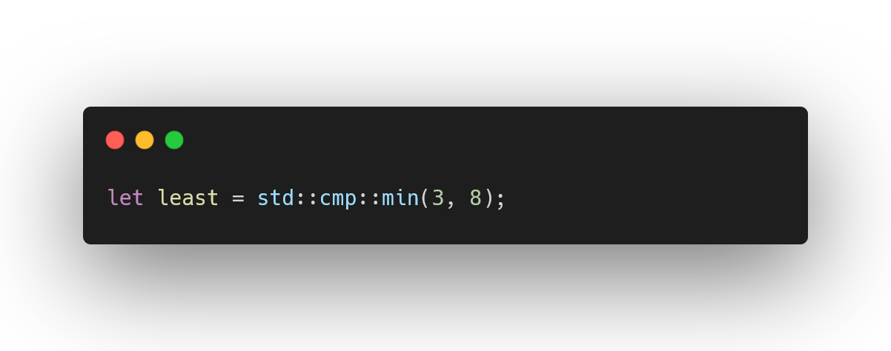
Namespaces

Slide 35
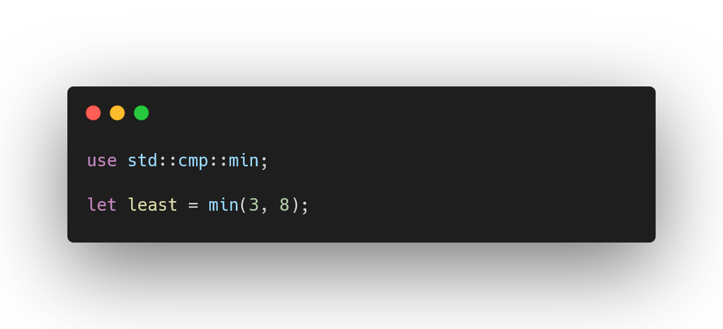
Using namespaces

Slide 36
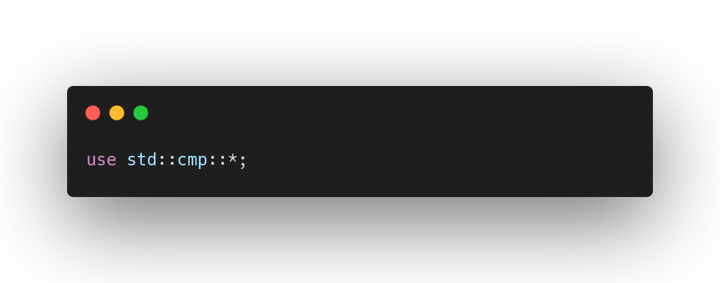
Importing entire namespaces

Slide 37
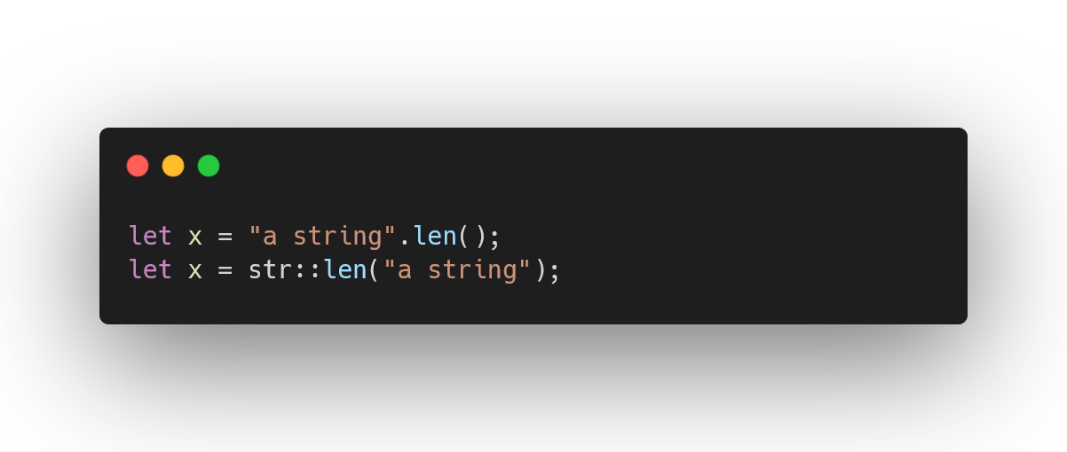
Types are namespaces

Slide 38
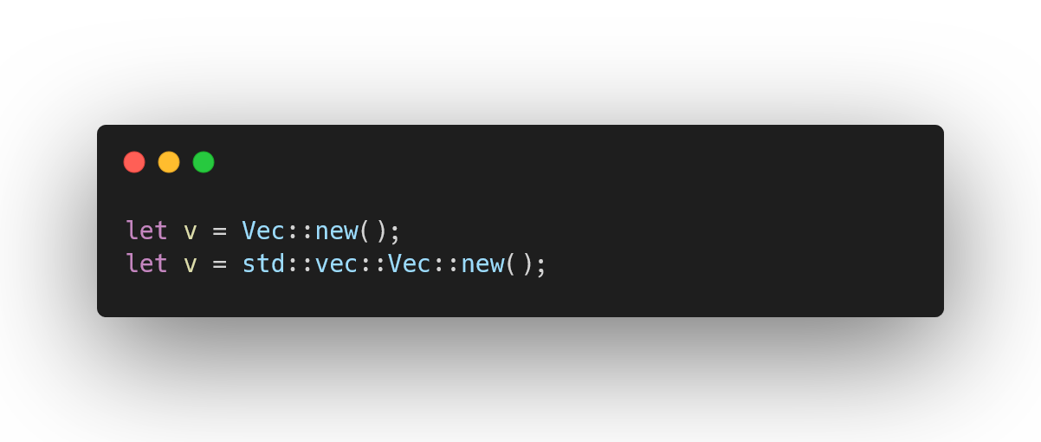
Some non-primitives in scope by default

Slide 39
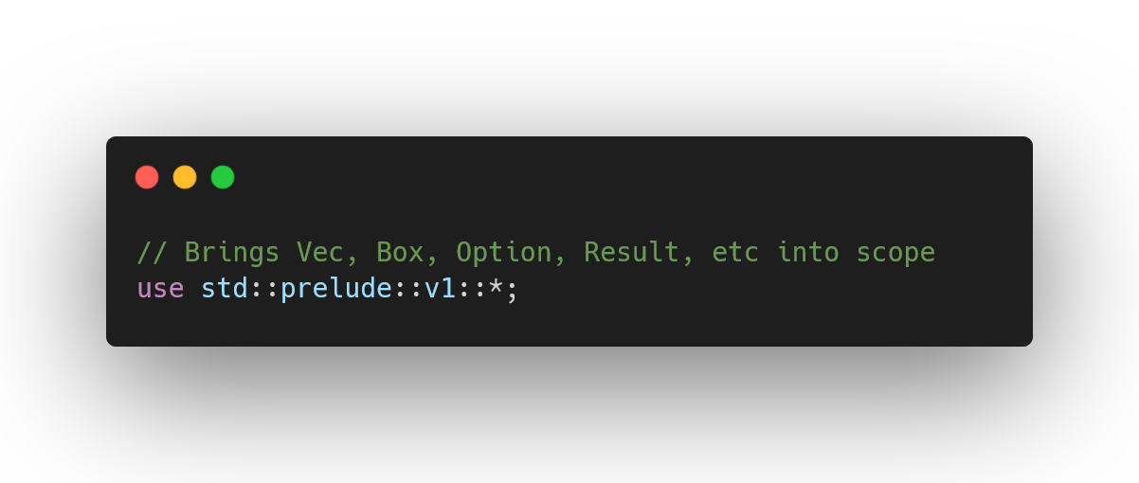
Rust compiler does this for you

Slide 40
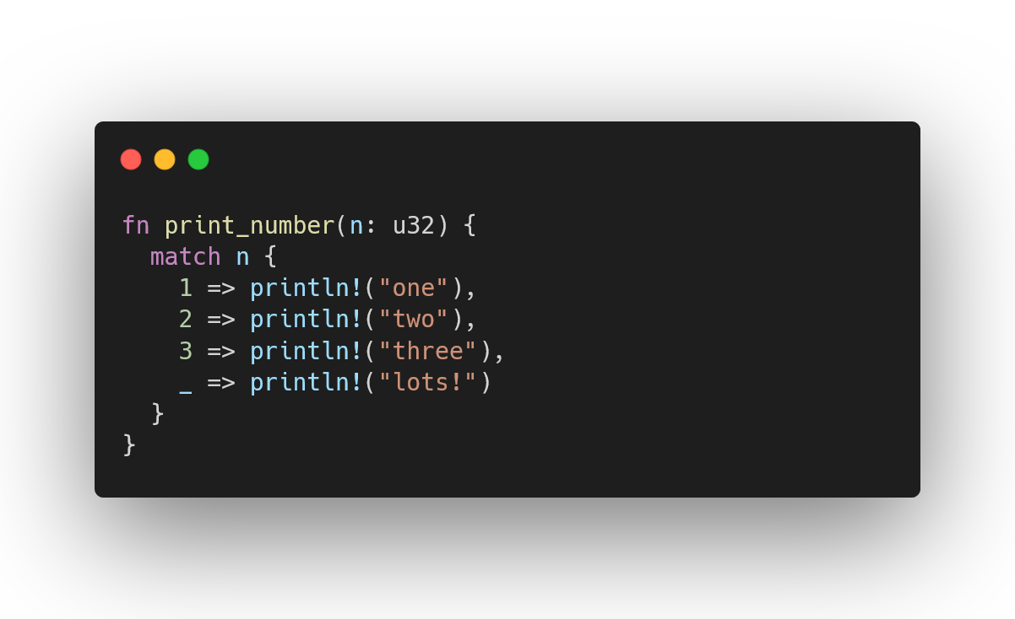
Match statements are concise control flow

Slide 41
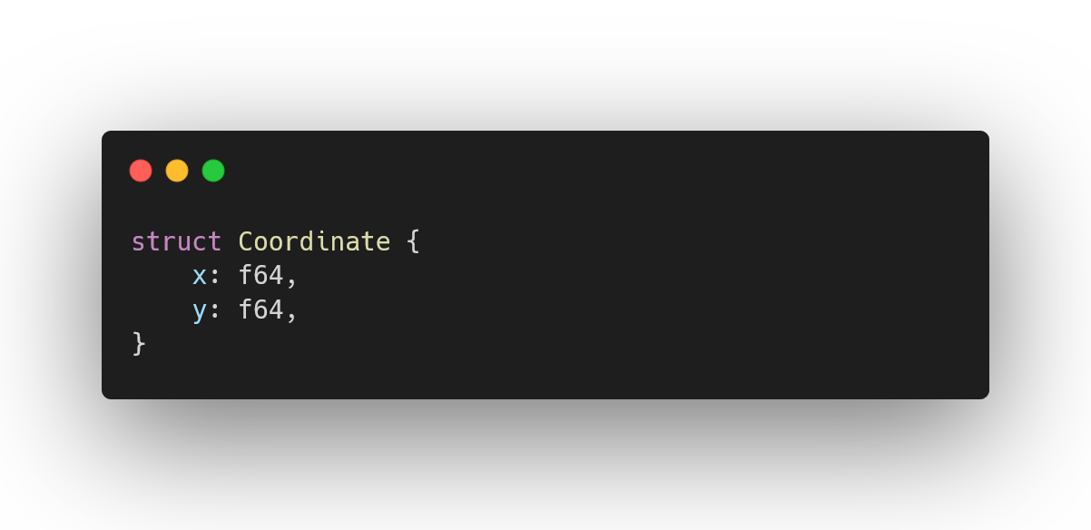
Structures combine data into one record

Slide 42
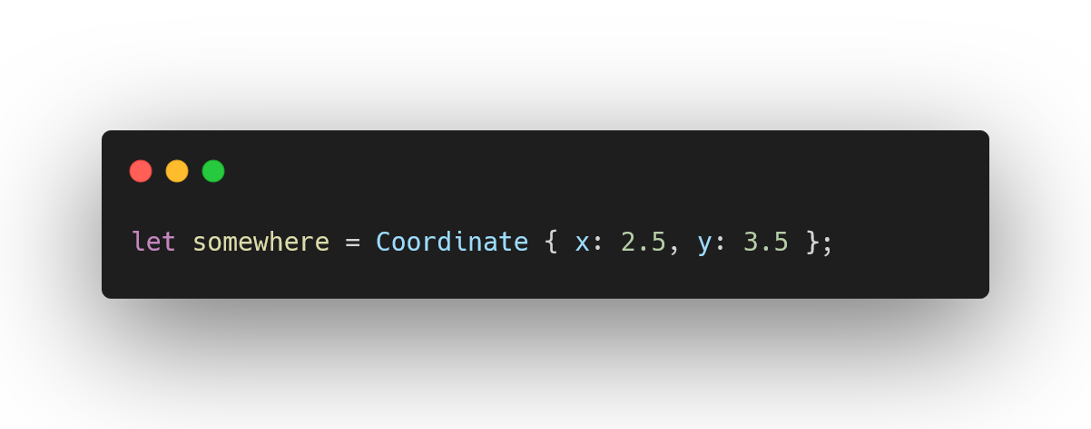
Structures are easy to initialise

Slide 43
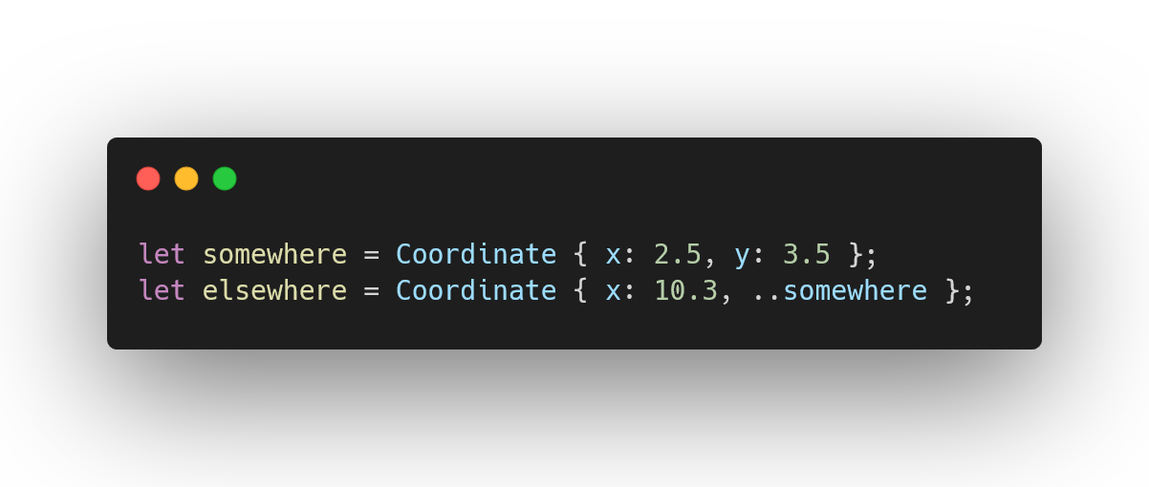
Shorthand initialisation

Slide 44
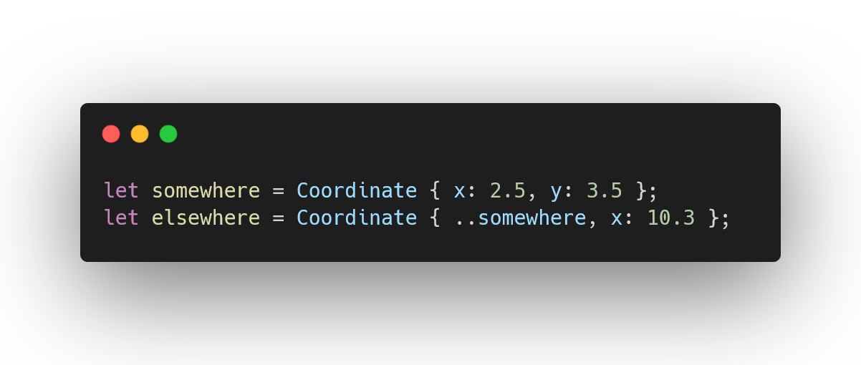
Shorthand used wrong

Slide 45
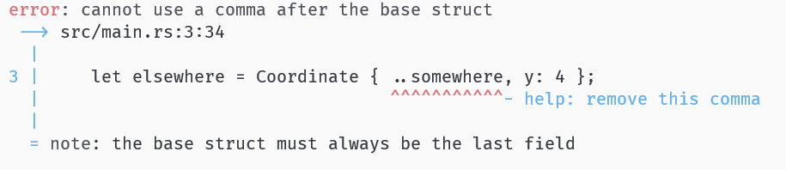
Shorthand used wrong

Slide 46
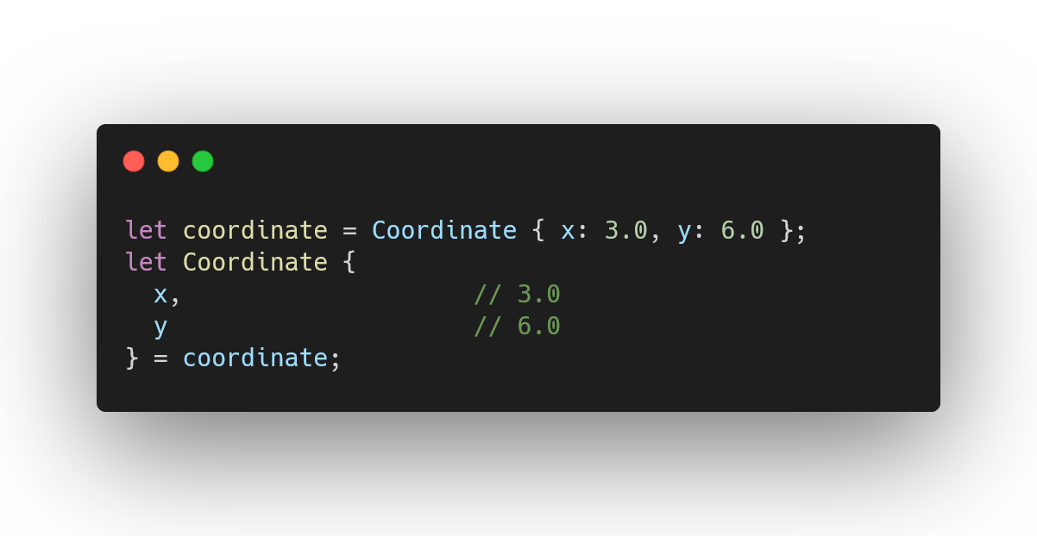
Structures can be deconstructed

Slide 47
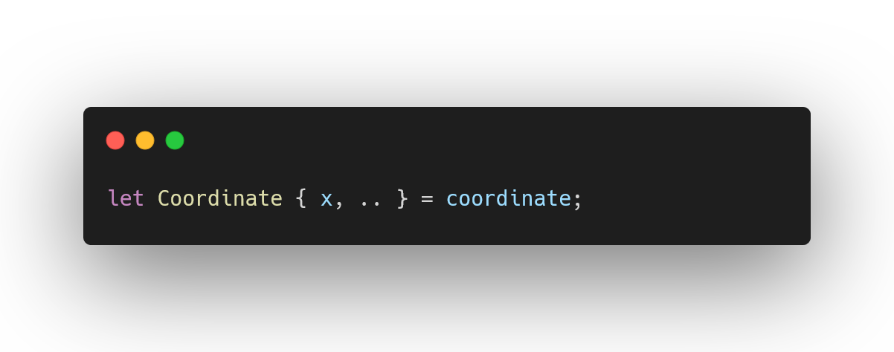
Deconstruction can discard attributes

Slide 48
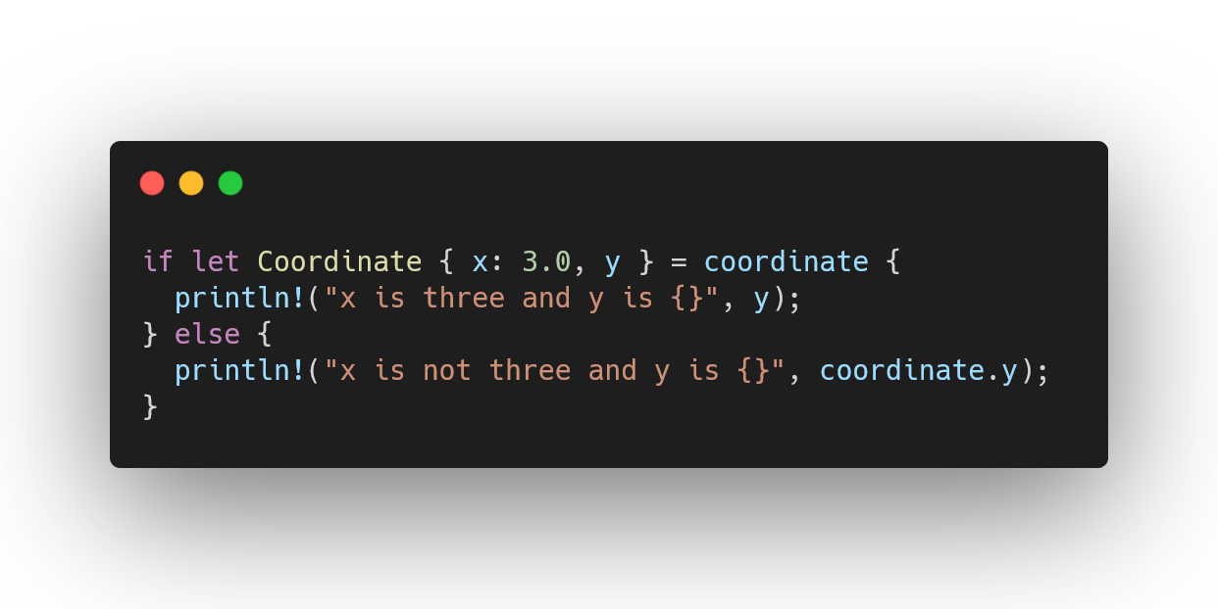
Let statements can be conditions

Slide 49
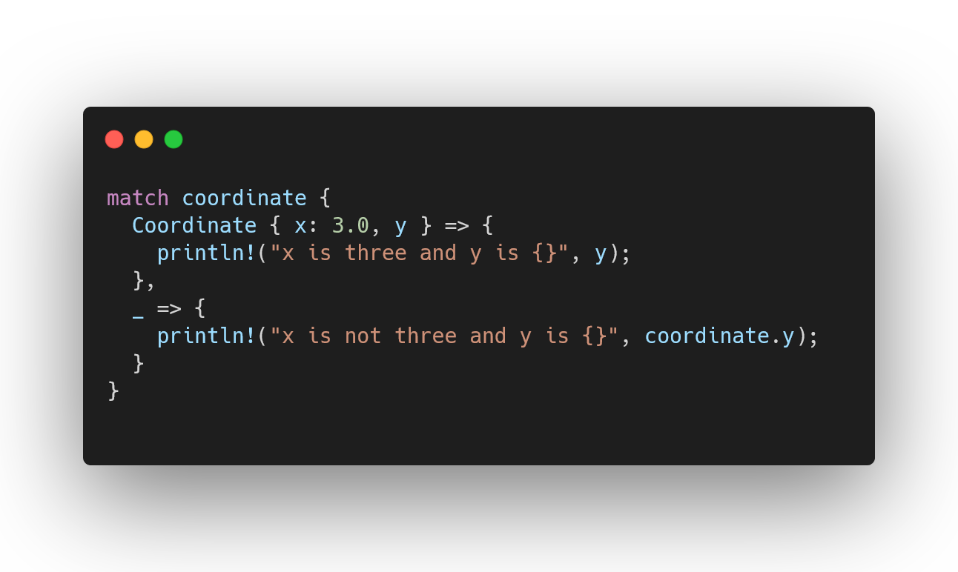
Match arms are also patterns

Slide 50
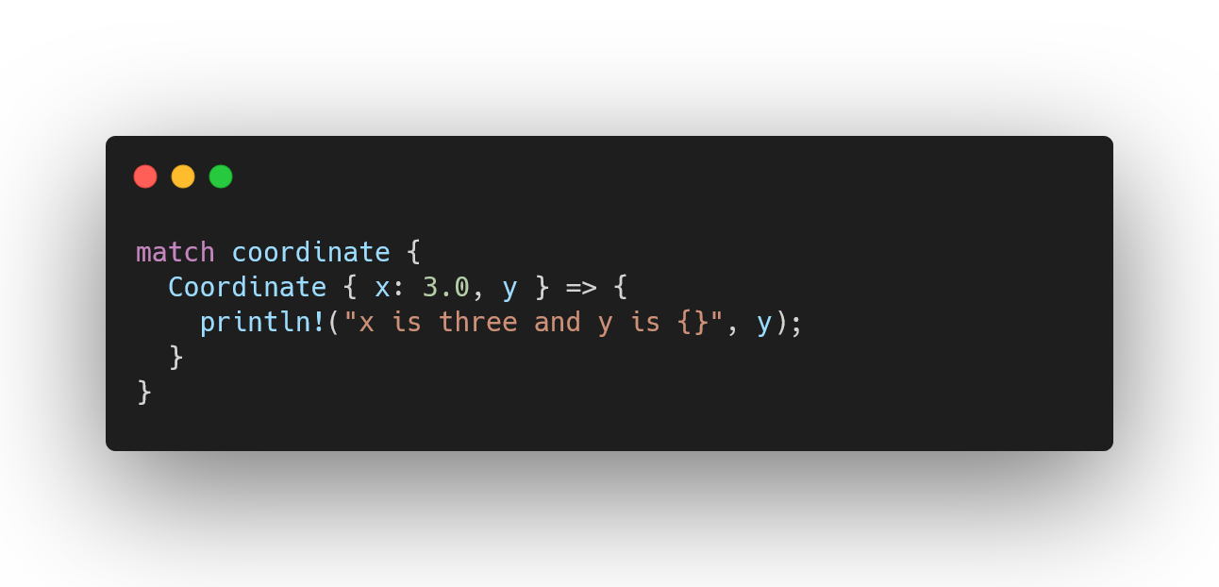
Match arms must be exhaustive

Slide 51
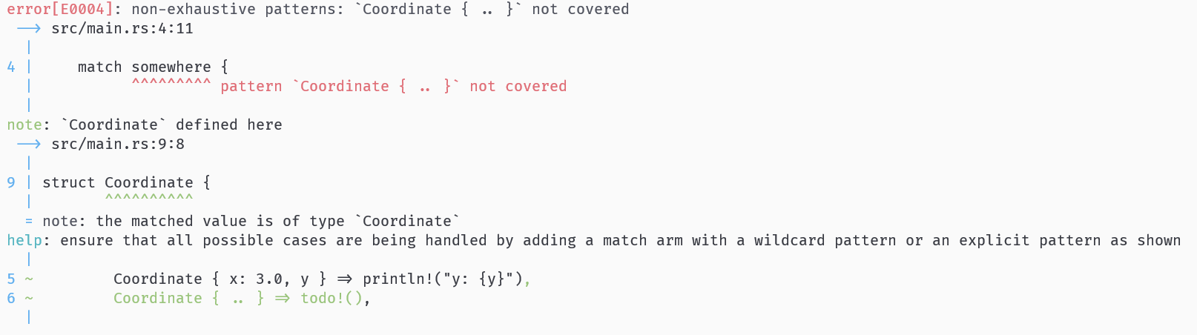
Match arms must be exhaustive

Slide 52
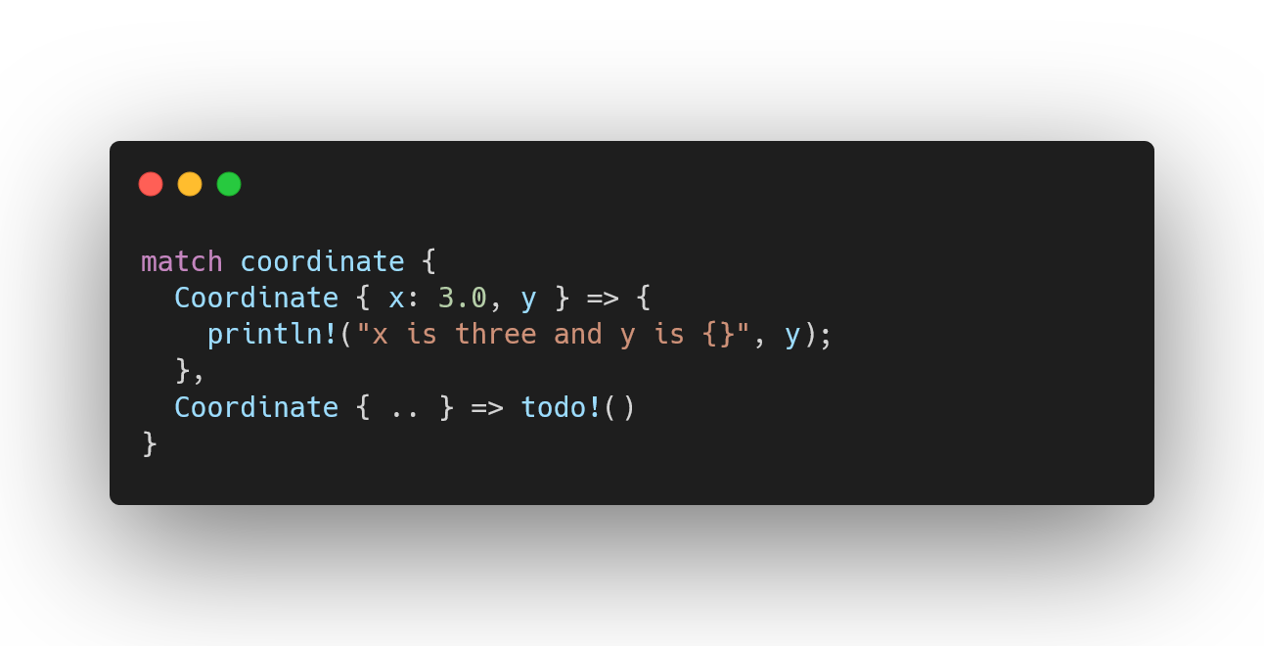
Match arms must be exhaustive

Slide 53
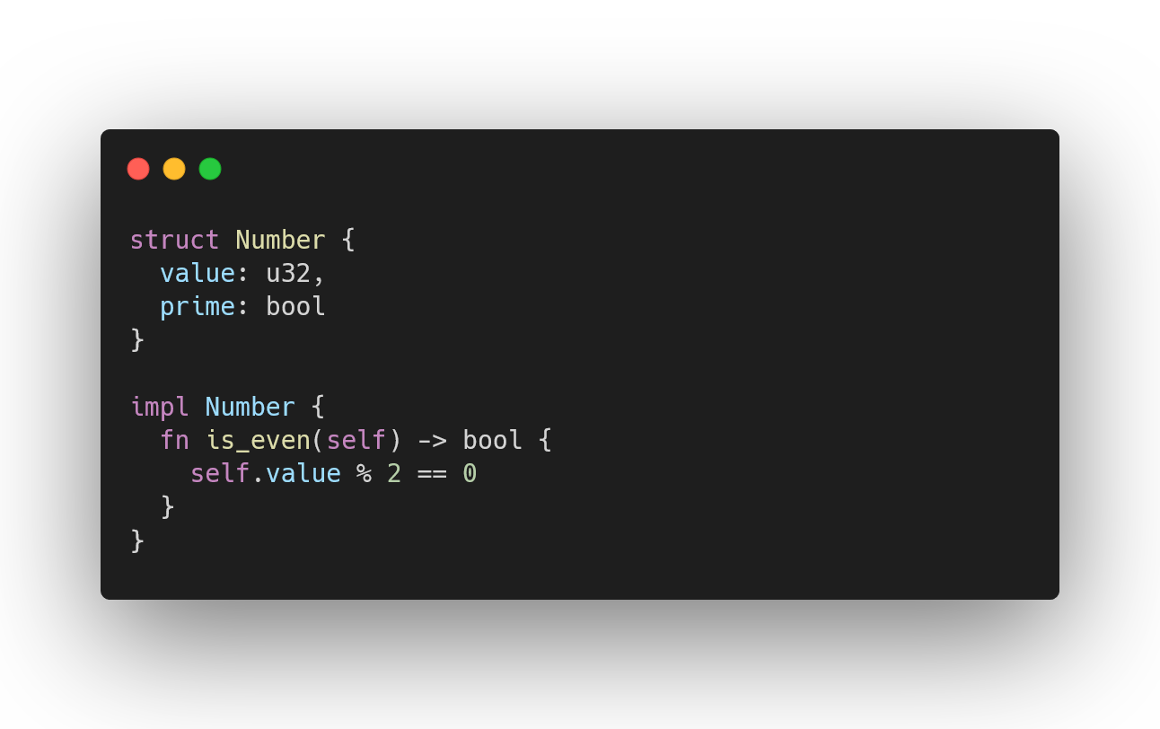
Types can have functions implemented for them

Slide 54
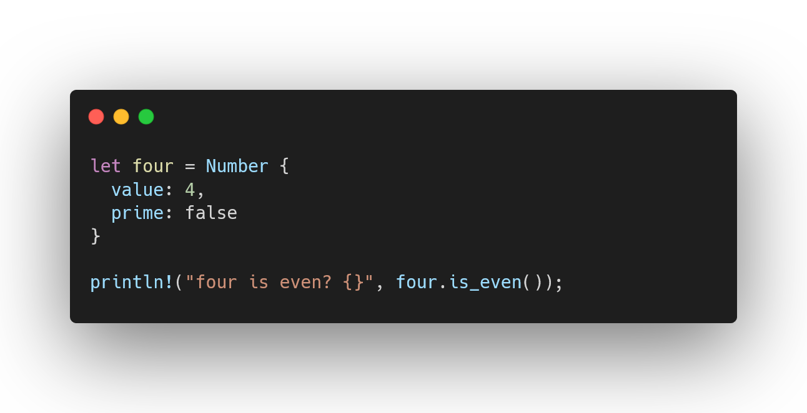
Types can have functions implemented for them

Slide 55
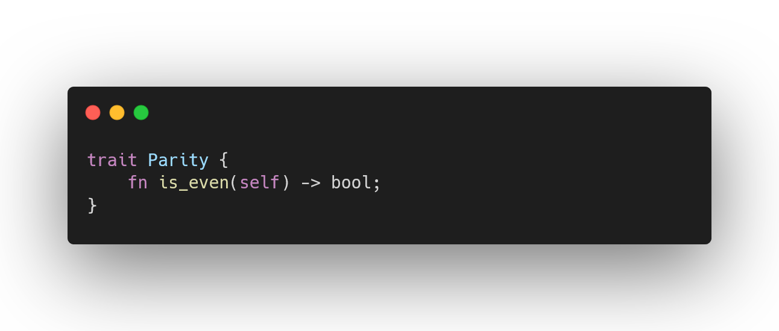
Traits are like type classes

Slide 56
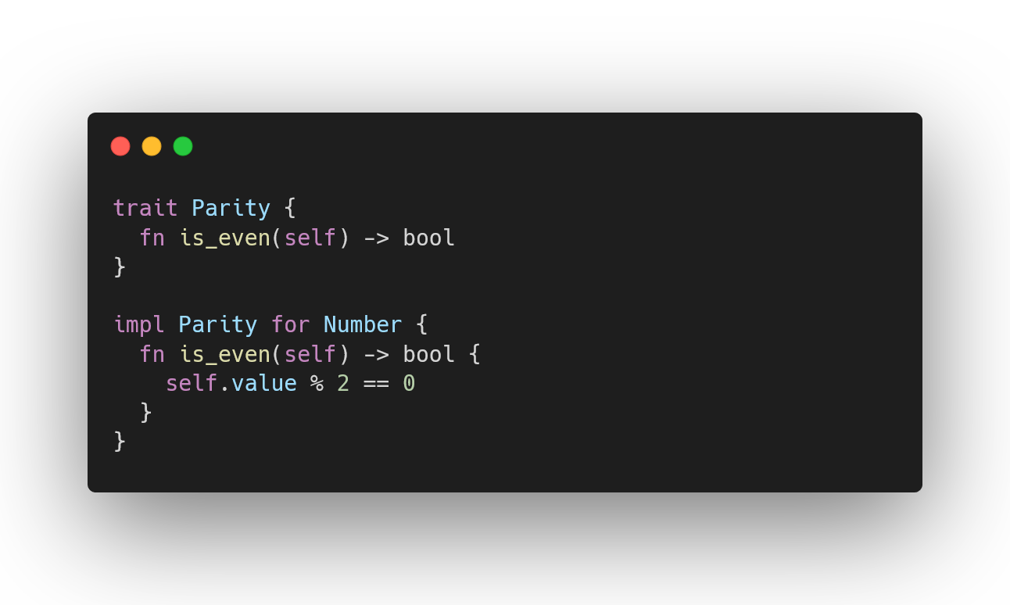
Traits are like type classes

Slide 57
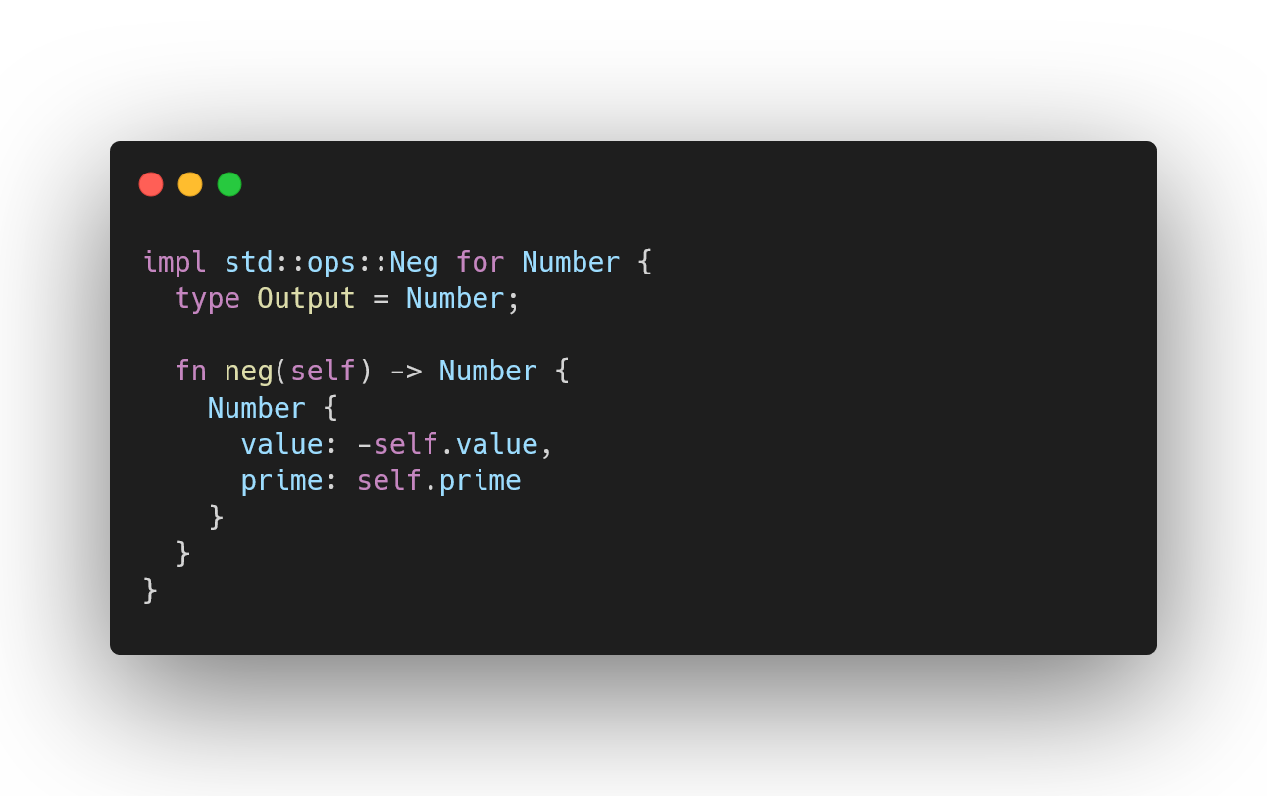
Implementing foreign traits on your own types

Slide 58
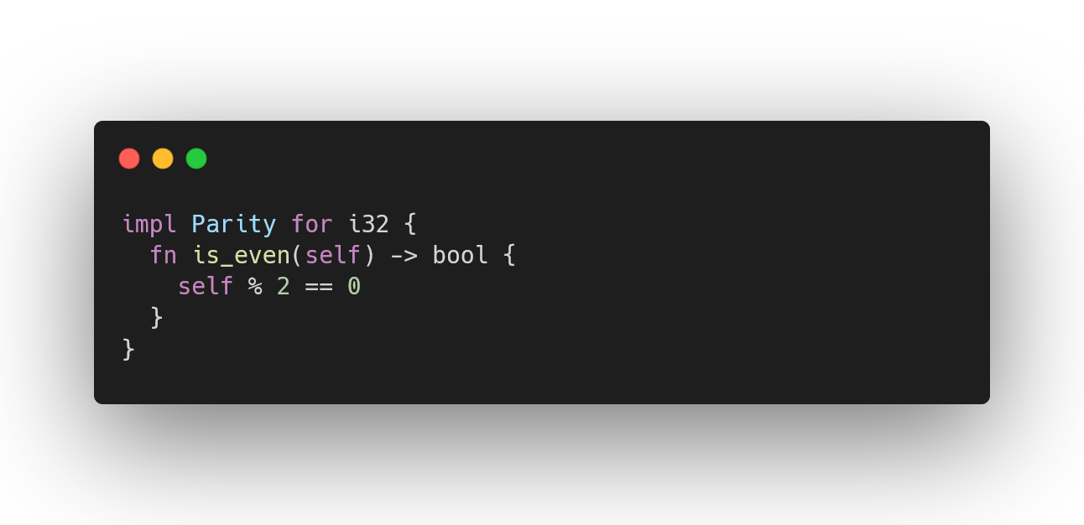
Implementing your own traits on foreign types

Slide 59
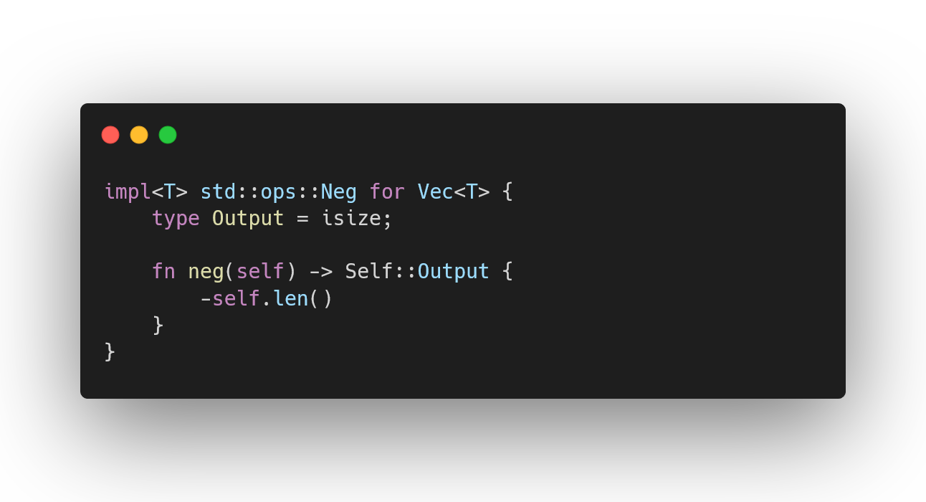
Implementing foreign traits on foreign types…?

Slide 60
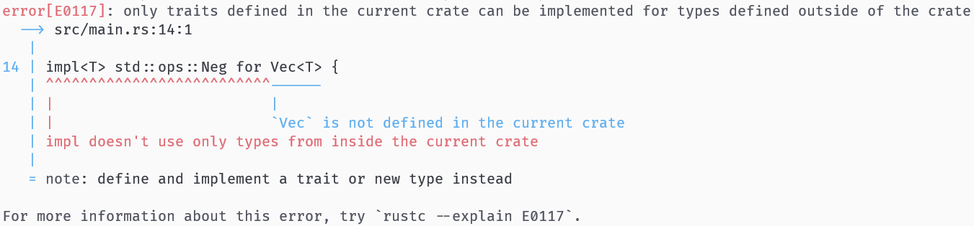
Implementing foreign traits on foreign types…?

Slide 61
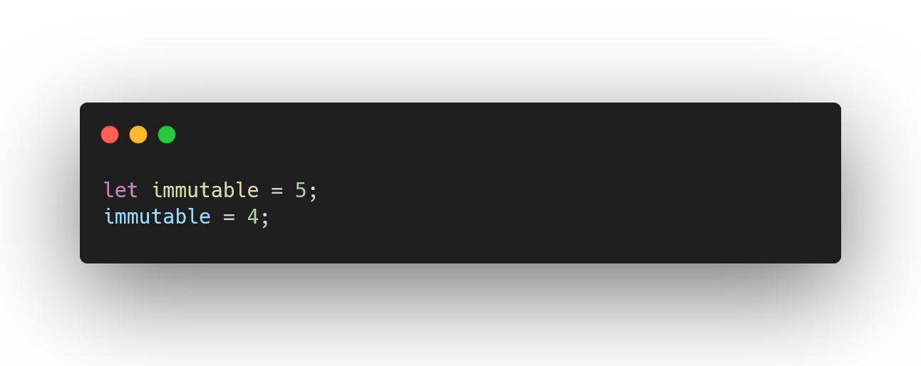
Immutability by default

Slide 62
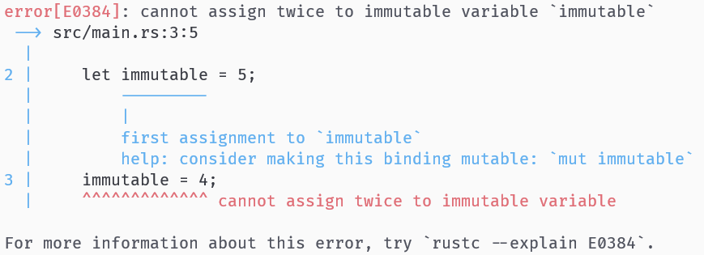
Immutability by default

Slide 63
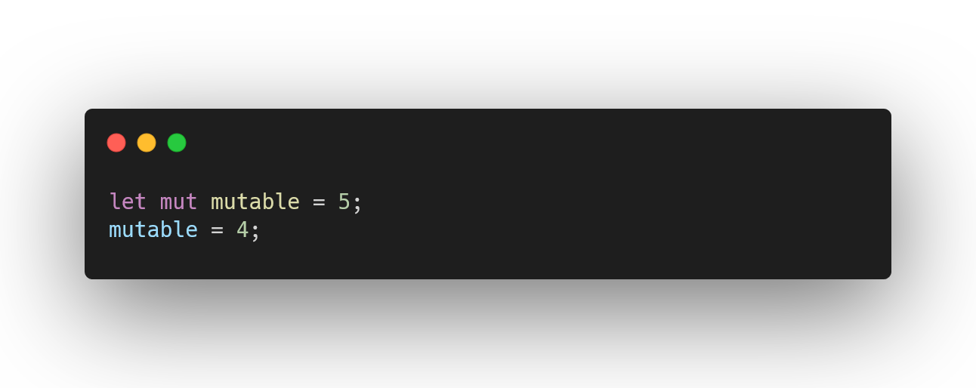
Opt-in mutability

Slide 64

Generic Functions

Slide 65

Generic Functions

Slide 66

Generics can be constrained by traits

Slide 67

Structures can also be generic

Slide 68

Structures can also be generic

Slide 69

Vectors can have literal definitions

Slide 70

Macros are metaprogramming

Slide 71

println!() is just a macro

Slide 72

Panics

Slide 73

Panics

Slide 74

Methods may panic

Slide 75

Methods may panic

Slide 76

Enums

Slide 77

Implementations on enums

Slide 78

Matching on enums

Slide 79

Result is also an enum

Slide 80

Matching on Results

Slide 81

Matching on Results

Slide 82

Bubble up errors (the verbose way)

Slide 83

Bubble up errors (the nice way)

Slide 84

Iterators

Slide 85

Ranges

Slide 86

Iterable can be used in a for loop

Slide 87
Time’s up!

Slide 88
You now know enough Rust to write your own programs

Slide 89
https://www.youtube.com/@NoBoilerplate
https://fasterthanli.me/articles/a-half-hour-to-learn-rust

Slide 90
Q&A

